Slide 1
Lecture 14
Main Memory

Slide 2
Objectives
To provide a detailed description of various ways of organizing memory hardware
To discuss various memory-management techniques, including paging and segmentation

Slide 3
Background
Program must be brought (from disk) into memory and placed within a process for it to be run
Main memory and registers are only storage CPU can access directly
Register access within one cycle of the CPU clock.
Main memory can take many cycles
Cache sits between main memory and CPU registers
Protection of memory required to ensure correct operation

Slide 4
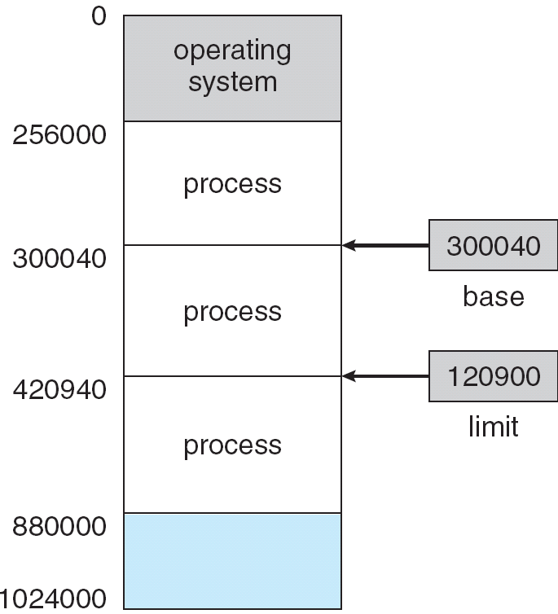
Base and Limit Registers
A pair of base and limit registers define the logical address space
Loaded/changed only by the OS with a privileged instruction in kernel mode.
The CPU compares each address generated by an instruction against the base and limit registers: hardware supported protection.

Slide 5
Binding of Instructions and
Data to Memory
Address binding of instructions and data to memory addresses can happen at three different stages
  Compile time: If memory location known a priori, absolute code can be generated; must recompile code if starting location changes
  Load time: Must generate relocatable code if memory location is not known at compile time
  Execution time: Binding delayed until run time if the process can be moved during its execution from one memory segment to another. Need hardware support for address maps (e.g., base and limit registers)

Slide 6
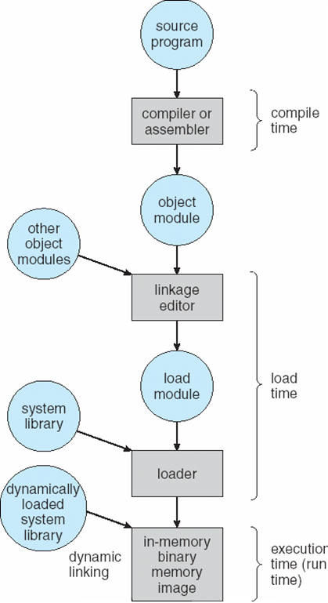
Multistep
Processing of a User
Program

Slide 7
Logical vs. Physical Address Space
The concept of a logical address space that is bound to a separate physical address space is central to proper memory management
  Logical address – generated by the CPU; also referred to as virtual address
  Physical address – address seen by the memory unit
Logical and physical addresses are the same in compile-time and load-time address-binding schemes; logical (virtual) and physical addresses differ in execution-time address-binding scheme

Slide 8
Memory-Management Unit (MMU)
Hardware device that maps virtual to physical address
In MMU scheme, the value in the relocation register is added to every address generated by a user process at the time it is sent to memory
The user program deals with logical addresses; it never sees the real physical addresses

Slide 9

Dynamic relocation using a relocation register

Slide 10
Dynamic Loading
Routine (i.e. function) is not loaded until it is called
Better memory-space utilization; unused routine is never loaded
Useful when large amounts of code are needed to handle infrequently occurring cases
No special support from the operating system is required
  implemented through program design

Slide 11
Dynamic Linking
Linking postponed until execution time
Small piece of code, stub, used to locate the appropriate memory-resident library routine
Stub replaces itself with the address of the routine, and executes the routine
Operating system needed to check if routine is in processes’ memory address
Dynamic linking is particularly useful for libraries
System also known as shared libraries

Slide 12
Swapping
A process can be swapped temporarily out of memory to a backing store, and then brought back into memory for continued execution
Backing store – fast disk large enough to accommodate copies of all memory images for all users; must provide direct access to these memory images
Roll out, roll in – swapping variant used for priority-based scheduling algorithms; lower-priority process is swapped out so higher-priority process can be loaded and executed
Major part of swap time is transfer time; total transfer time is directly proportional to the amount of memory swapped
Modified versions of swapping are found on many systems (i.e., UNIX, Linux, and Windows)
System maintains a ready queue of ready-to-run processes which have memory images on disk

Slide 13

Schematic View of Swapping

Slide 14
Contiguous Allocation
Main memory usually into two partitions:
  Resident operating system, usually held in low memory with interrupt vector
  User processes then held in high memory
Relocation registers used to protect user processes from each other, and from changing operating-system code and data
  Base register contains value of smallest physical address
  Limit register contains range of logical addresses – each logical address must be less than the limit register
  MMU maps logical address dynamically

Slide 15

Hardware Support for Relocation and
Limit Registers

Slide 16
Contiguous Allocation (Cont)
Multiple-partition allocation
  Hole – block of available memory; holes of various size are scattered throughout memory
  When a process arrives, it is allocated memory from a hole large enough to accommodate it
  Operating system maintains information about:
  a) allocated partitions b) free partitions (hole)
OS
OS
OS
OS
process 5
process 5
process 5
process 5
process 9
process 9
process 8
process 10
process 2
process 2
process 2
process 2

Slide 17
Dynamic Storage-Allocation Problem
How to satisfy a request of size n from a list of free holes
First-fit: Allocate the first hole that is big enough
Best-fit: Allocate the smallest hole that is big enough; must search entire list, unless ordered by size
  Produces the smallest leftover hole
Worst-fit: Allocate the largest hole; must also search entire list
  Produces the largest leftover hole
First-fit and best-fit better than worst-fit in terms of speed and storage utilization

Slide 18
Fragmentation
External Fragmentation – total memory space exists to satisfy a request, but it is not contiguous
Internal Fragmentation – allocated memory may be slightly larger than requested memory; this size difference is memory internal to a partition, but not being used
Reduce external fragmentation by compaction
  Shuffle memory contents to place all free memory together in one large block
  Compaction is possible only if relocation is dynamic, and is done at execution time

Slide 19
Paging
Logical address space of a process can be noncontiguous; process is allocated physical memory whenever the latter is available
Divide physical memory into fixed-sized blocks called frames (size is power of 2, between 512 bytes and 8,192 bytes)
Divide logical memory into blocks of same size called pages
Keep track of all free frames
To run a program of size n pages, need to find n free frames and load program
Set up a page table to translate logical to physical addresses
Internal fragmentation

Slide 20
Address Translation Scheme
Address generated by CPU is divided into:
  Page number (p) – used as an index into a page table which contains base address of each page in physical memory
  Page offset (d) – combined with base address to define the physical memory address that is sent to the memory unit
  For given logical address space 2^{m} and page size 2^{n}
page number
page offset
p
d
m - n
n

Slide 21
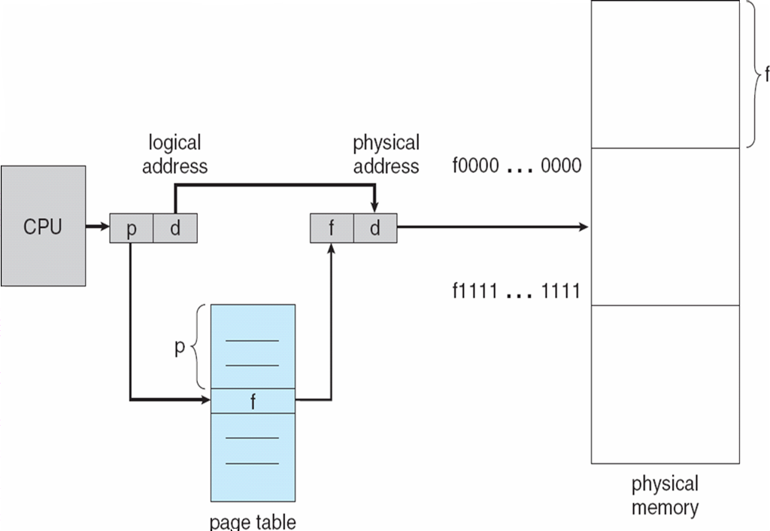
Paging Hardware

Slide 22

Paging Model of Logical and Physical Memory

Slide 23

Paging Example
32-byte memory and 4-byte pages

Slide 24

Free Frames
Before allocation
After allocation

Slide 25
Implementation of Page Table
Page table is kept in main memory
Page-table base register (PTBR) points to the page table
Page-table length register (PRLR) indicates size of the page table
In this scheme every data/instruction access requires two memory accesses. One for the page table and one for the data/instruction.
The two memory access problem can be solved by the use of a special fast-lookup hardware cache called associative memory or translation look-aside buffers (TLBs)
Some TLBs store address-space identifiers (ASIDs) in each TLB entry – uniquely identifies each process to provide address-space protection for that process

Slide 26
Associative Memory
Associative memory – parallel search
Address translation (p, d)
  If p is in associative register, get frame # out
  Otherwise get frame # from page table in memory
Page #
Frame #

Slide 27

Paging Hardware With TLB

